Slide 1

Beijing City Feature-Based
irbnb Price Prediction
Team GeekHub
Brian Feng Mike Liu
Tony Li Logan Luo

Slide 2
Outline
Motivation
Problem Definition
State-of-the-Art
Methodology
Evaluation

Slide 3
Motivation

Slide 4
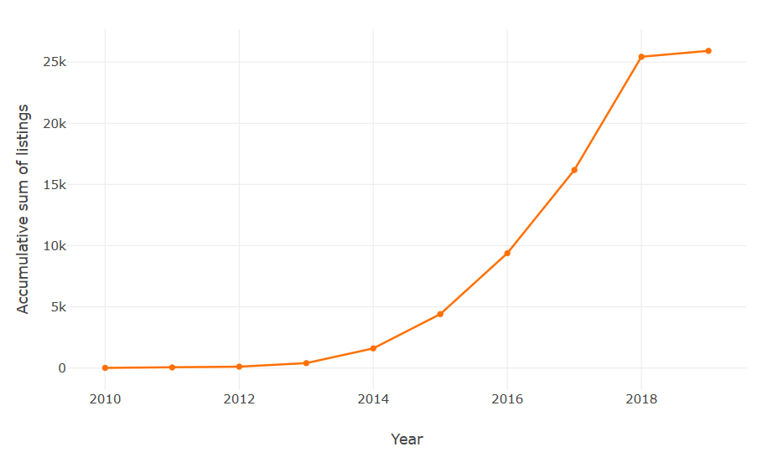
Motivation · Problem Definition · State-of-the-Art · Methodology · Evaluation
Accumulative number of listings year by year since 2010 in Airbnb Beijing
Beijing

Slide 5

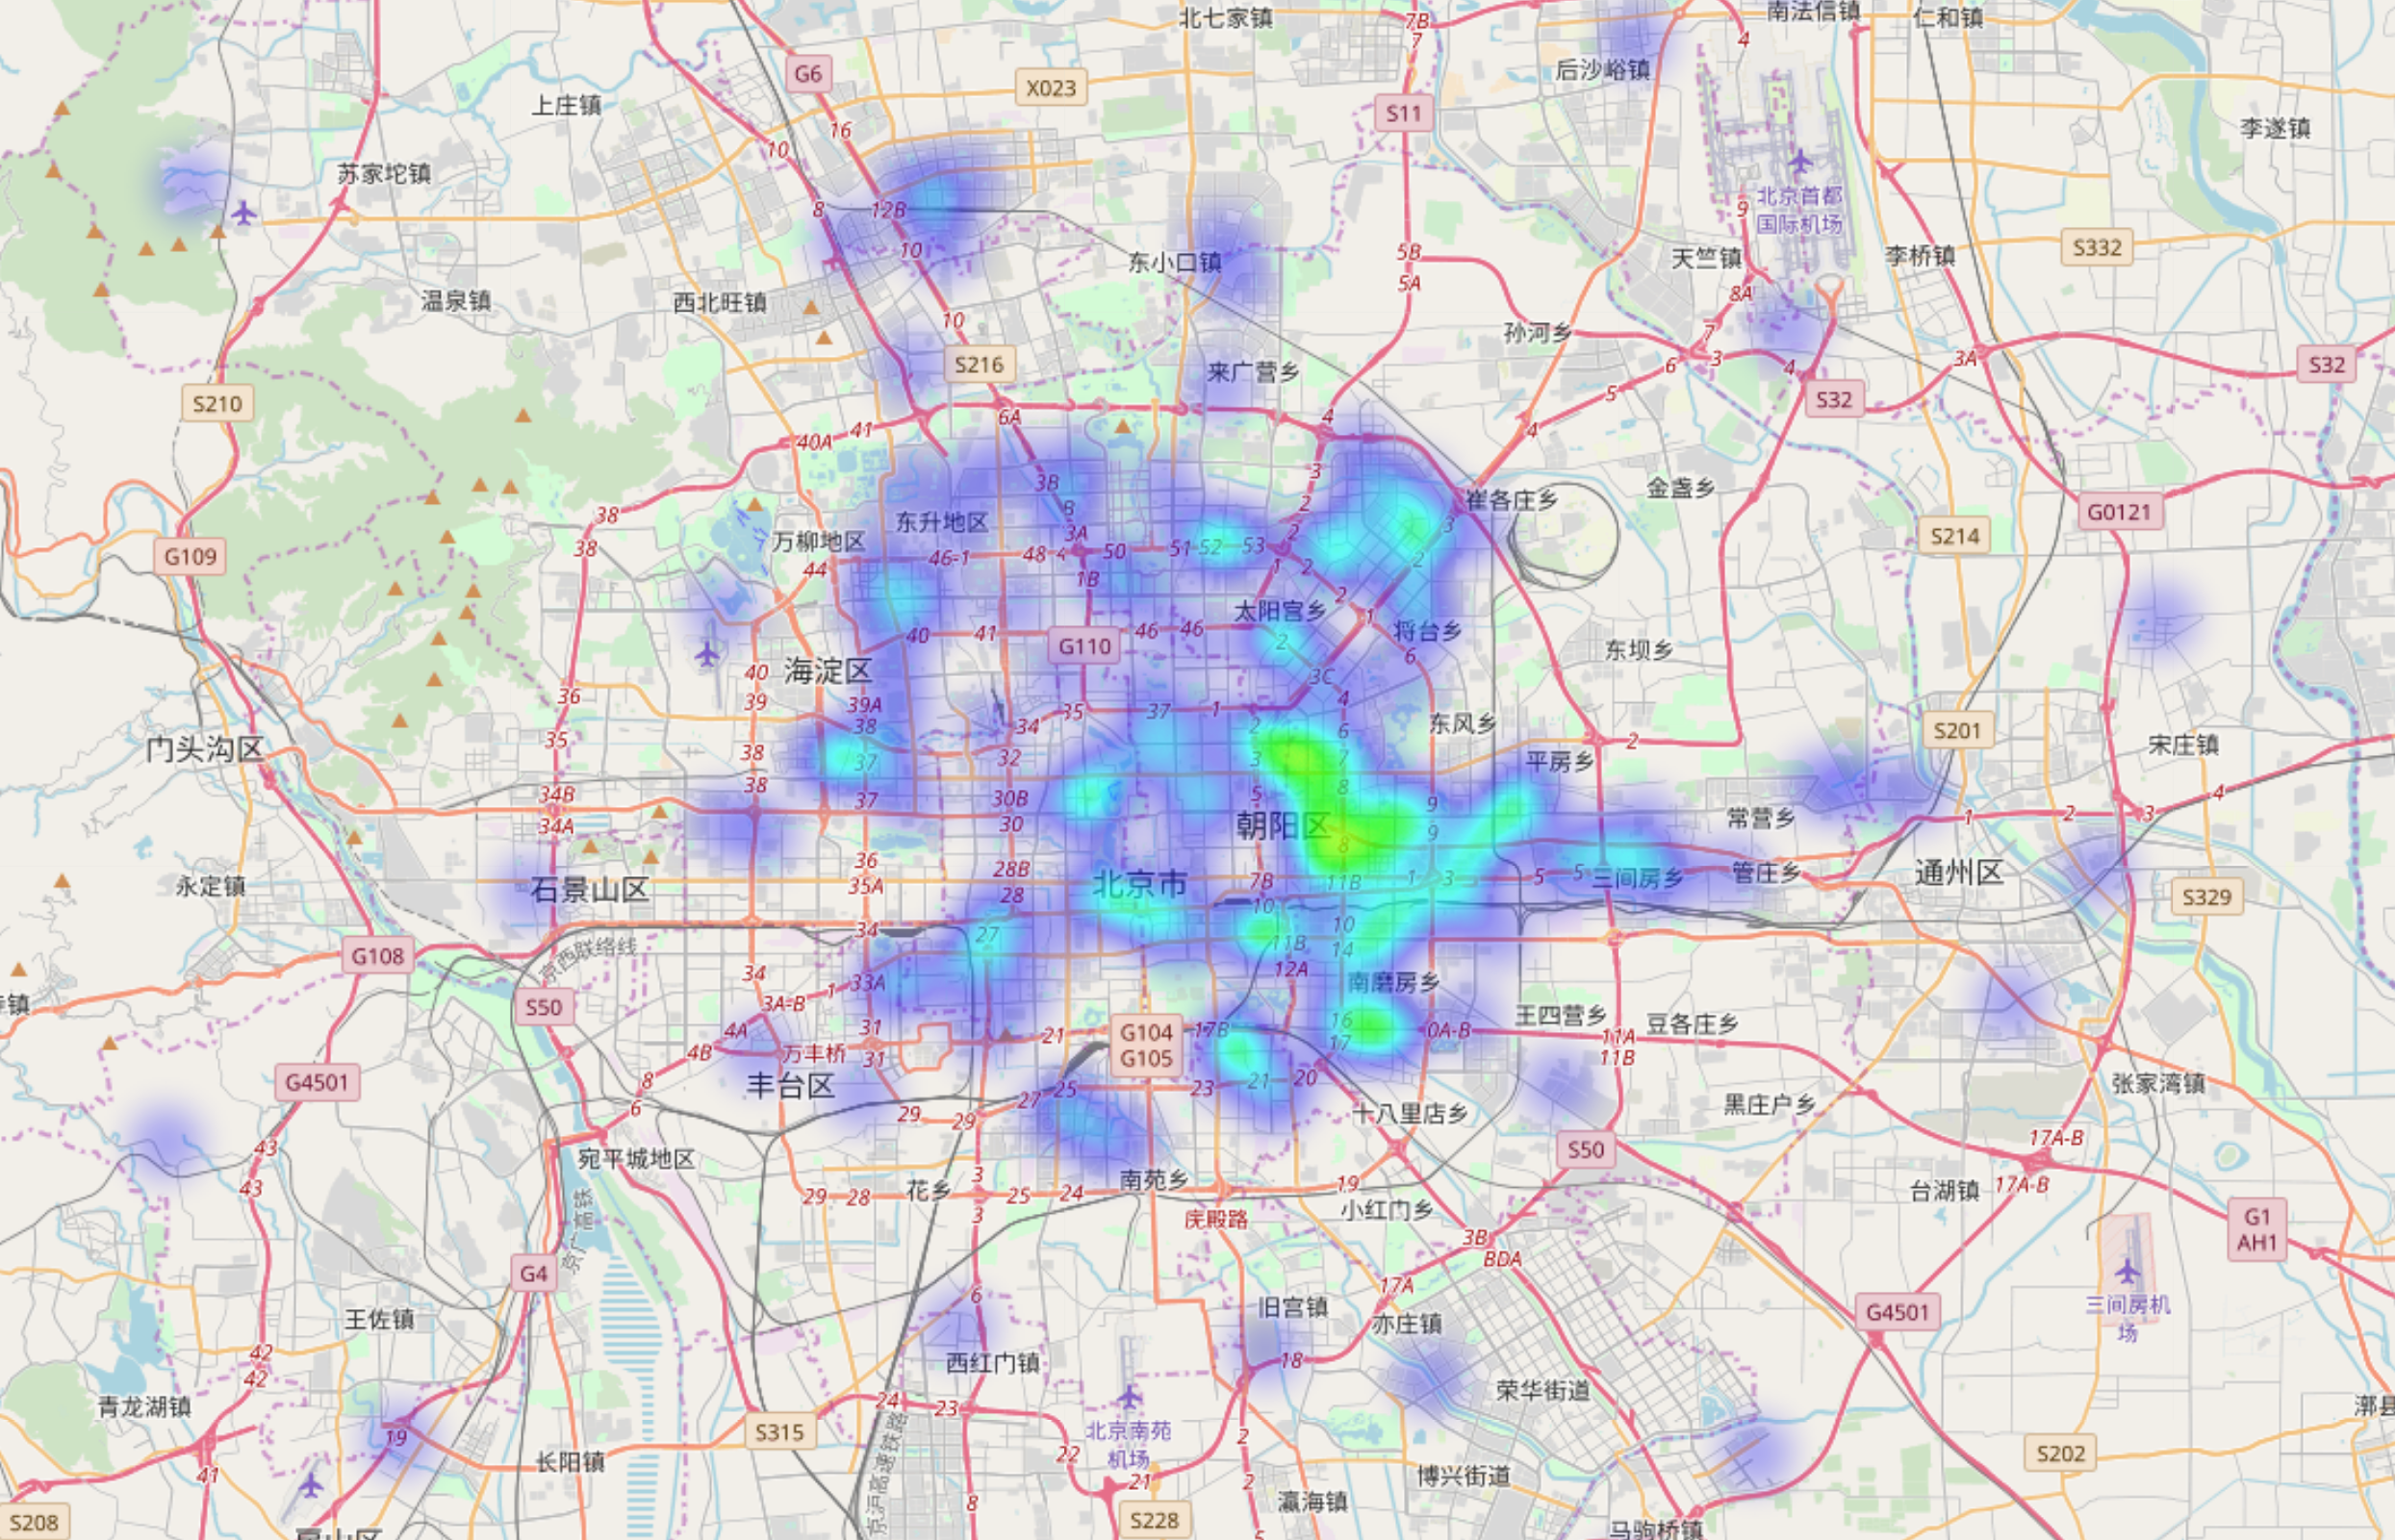
Motivation · Problem Definition · State-of-the-Art · Methodology · Evaluation
2012

Slide 6
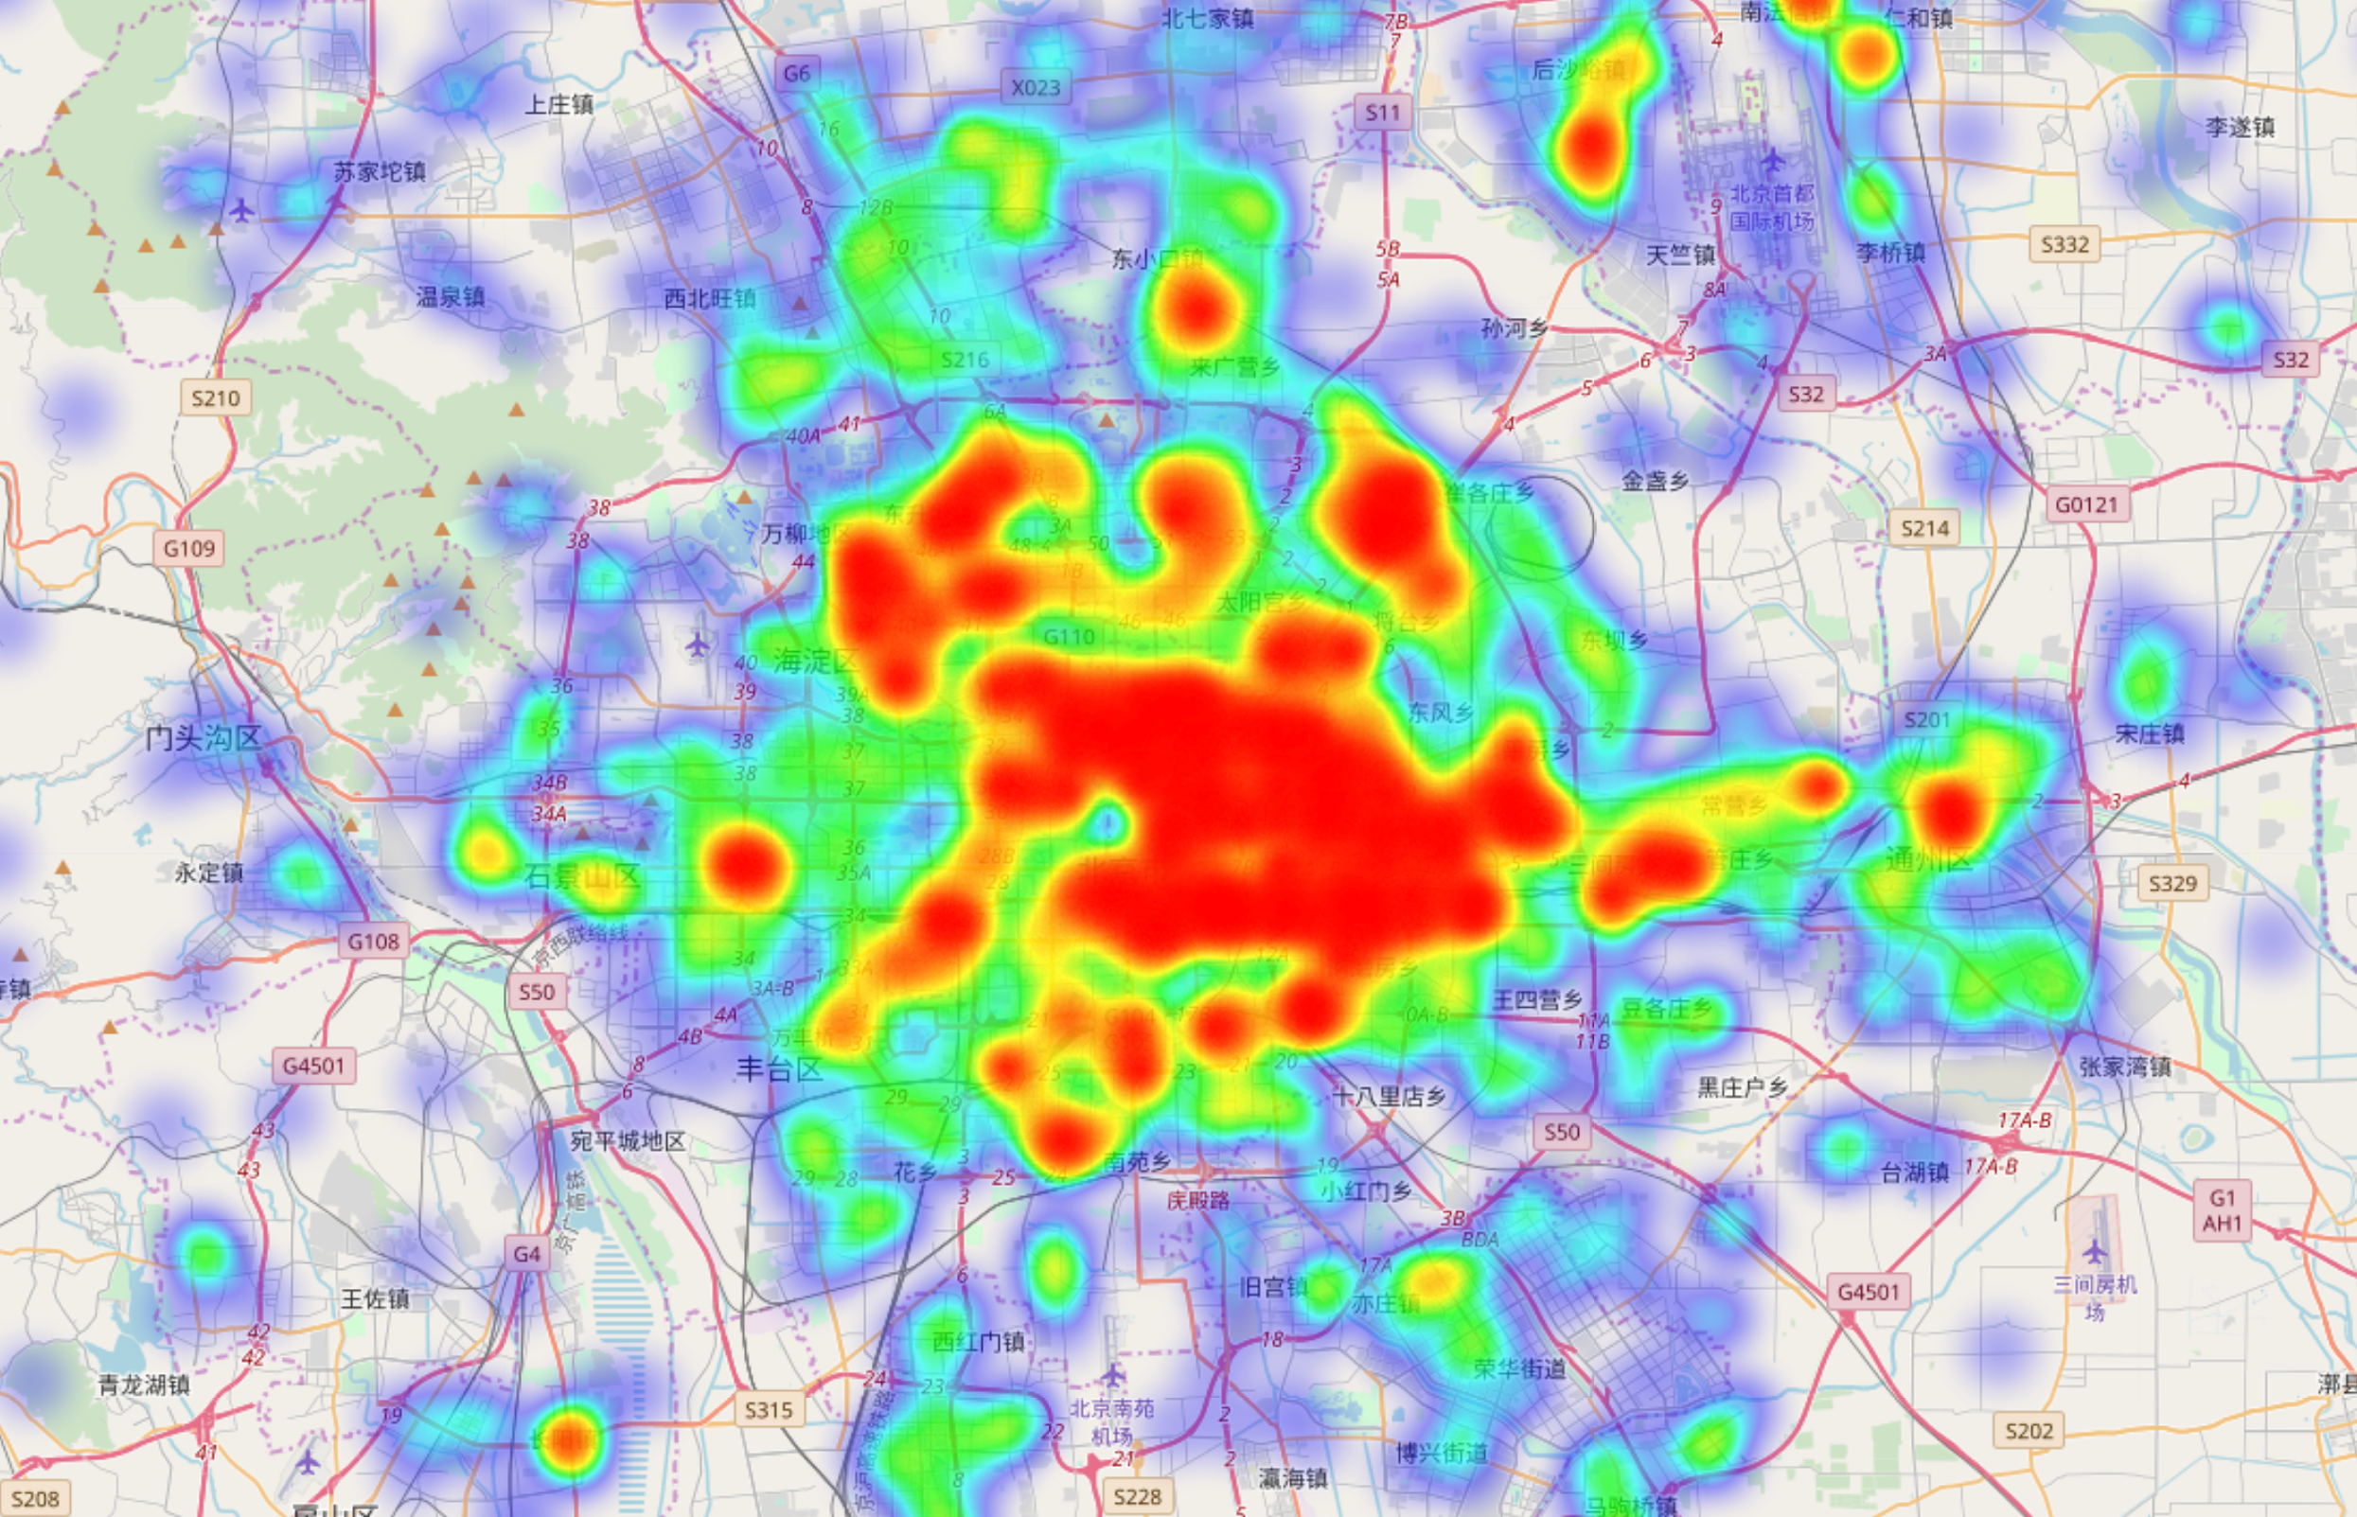
Motivation · Problem Definition · State-of-the-Art · Methodology · Evaluation
2019

Slide 7





Motivation · Problem Definition · State-of-the-Art · Methodology · Evaluation
?
The Best Price is
3 Giant Rooms
豪宅
Swimming Pool
Big TVs
Intelligent Machine
Landlord Mr. Lazy

Slide 8
Problem Definition

Slide 9

Problem Statement
Motivation · Problem Definition · State-of-the-Art · Methodology · Evaluation
Given a series of data describes the property’s features.
Output the reasonable/best price point for the host.

Slide 10
Motivation · Problem Definition · State-of-the-Art · Methodology · Evaluation
$$f\left(Capacity, Location,…, RoomType, ReviewScore\right)+β_{0}⇒Price$$

Slide 11
State-of-the-Art

Slide 12
Motivation · Problem Definition · State-of-the-Art · Methodology · Evaluation
A brief review of the literature on price influencing factors
Dimension | Factors | Effects | Author
External | Price in cities | N/A | Stephen and Andrew(2016)
 | Number of owners Distance between owners | Pos/Neg | Balaguer and Pernias(2013), Becerra(2013)
Location | Distance | Negative | Bull(1994), Wang & Nicolau(2017), Li (2016), Huang(2010)
House | Room type | Negative | Wang & Nicolau(2017), Zhang(2017)
 | Room type | Positive
Room | Bedroom, bathroom, bed | Positive
Rule | Instant bookable | Negative
 | Cancellation policy | Positive
Sociality | Number of reviews per year | Negative | Wang & Nicolau(2017), Zhang(2017)
 |  | Positive | Zhu Lv(2017), Gutt & Herrmann(2015)
 | Host identity verified | Pos/Neg | Wang & Nicolau(2017)
 |  | Positive | Zhu Lv(2017)

Slide 13

Motivation · Problem Definition · State-of-the-Art · Methodology · Evaluation
Get Data
Feature Engineering
Tuning Models
Outputs

Slide 14
Methodology

Slide 15
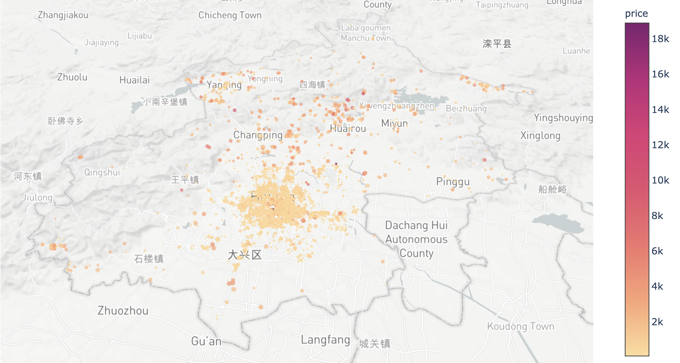

Motivation · Problem Definition · State-of-the-Art · Methodology · Evaluation
Get Data
Raw_Data-Airbnb_Beijing.csv
Total:
19360 Listings
All available Data in Airbnb

Slide 16
Motivation · Problem Definition · State-of-the-Art · Methodology · Evaluation
Data Pre-Processing
Drop Properties that lacks too many features (less than 100)
Drop Properties with unreasonable prices (i.e. the host didn’t actually want to Airbnb it)
[Price < (￥50 * accommodates) OR (￥50 * beds)]
[Price > ￥20,000 OR Price = ￥9999]
[Beds=50 OR Bathrooms=101 OR min_nights > 3]
Fill up a few fixable nulls.

Slide 17
Motivation · Problem Definition · State-of-the-Art · Methodology · Evaluation
ID | Capacity | Room types | Price | …
44054 | 9 | Entire home | 816 | …
100213 | 2 | Entire home | 1203 | …
128496 | 3 | Private room | 401 | …
161902 | 2 | Private room | 387 | …
162144 | 4 | Private room | 553 | …
279078 | 2 | Entire home | 401 | …
282825 | 4 | Entire home | 657 | …
287026 | 3 | Entire home | 415 | …
287511 | 3 | Entire home | 415 | …
317195 | 2 | Private room | 546 | …
322292 | 2 | Entire home | 436 | …
… | … | … | … | …
Airbnb_listings_Beijing.csv
19360 Listings
→
17224 Listings

Slide 18
Motivation · Problem Definition · State-of-the-Art · Methodology · Evaluation
Feature Engineering
Our apartments are located in the CBD …
2562442
bathrooms | description | host_id
bedrooms | summary | host_location
beds | amenities | city
bed type | name | zipcode
…… | …… | ……
availability | overview | thumbnail
Extra people | abstract | host verifications

Slide 19
Motivation · Problem Definition · State-of-the-Art · Methodology · Evaluation
Feature Engineering
Our apartments are located in the CBD …
2562442
bathrooms | description | host_id
bedrooms | summary | host_location
beds | amenities | city
bed type | name | zipcode
…… | …… | ……
availability | overview | thumbnail
Extra people | abstract | host verifications
incapable
Irrelevant

Slide 20
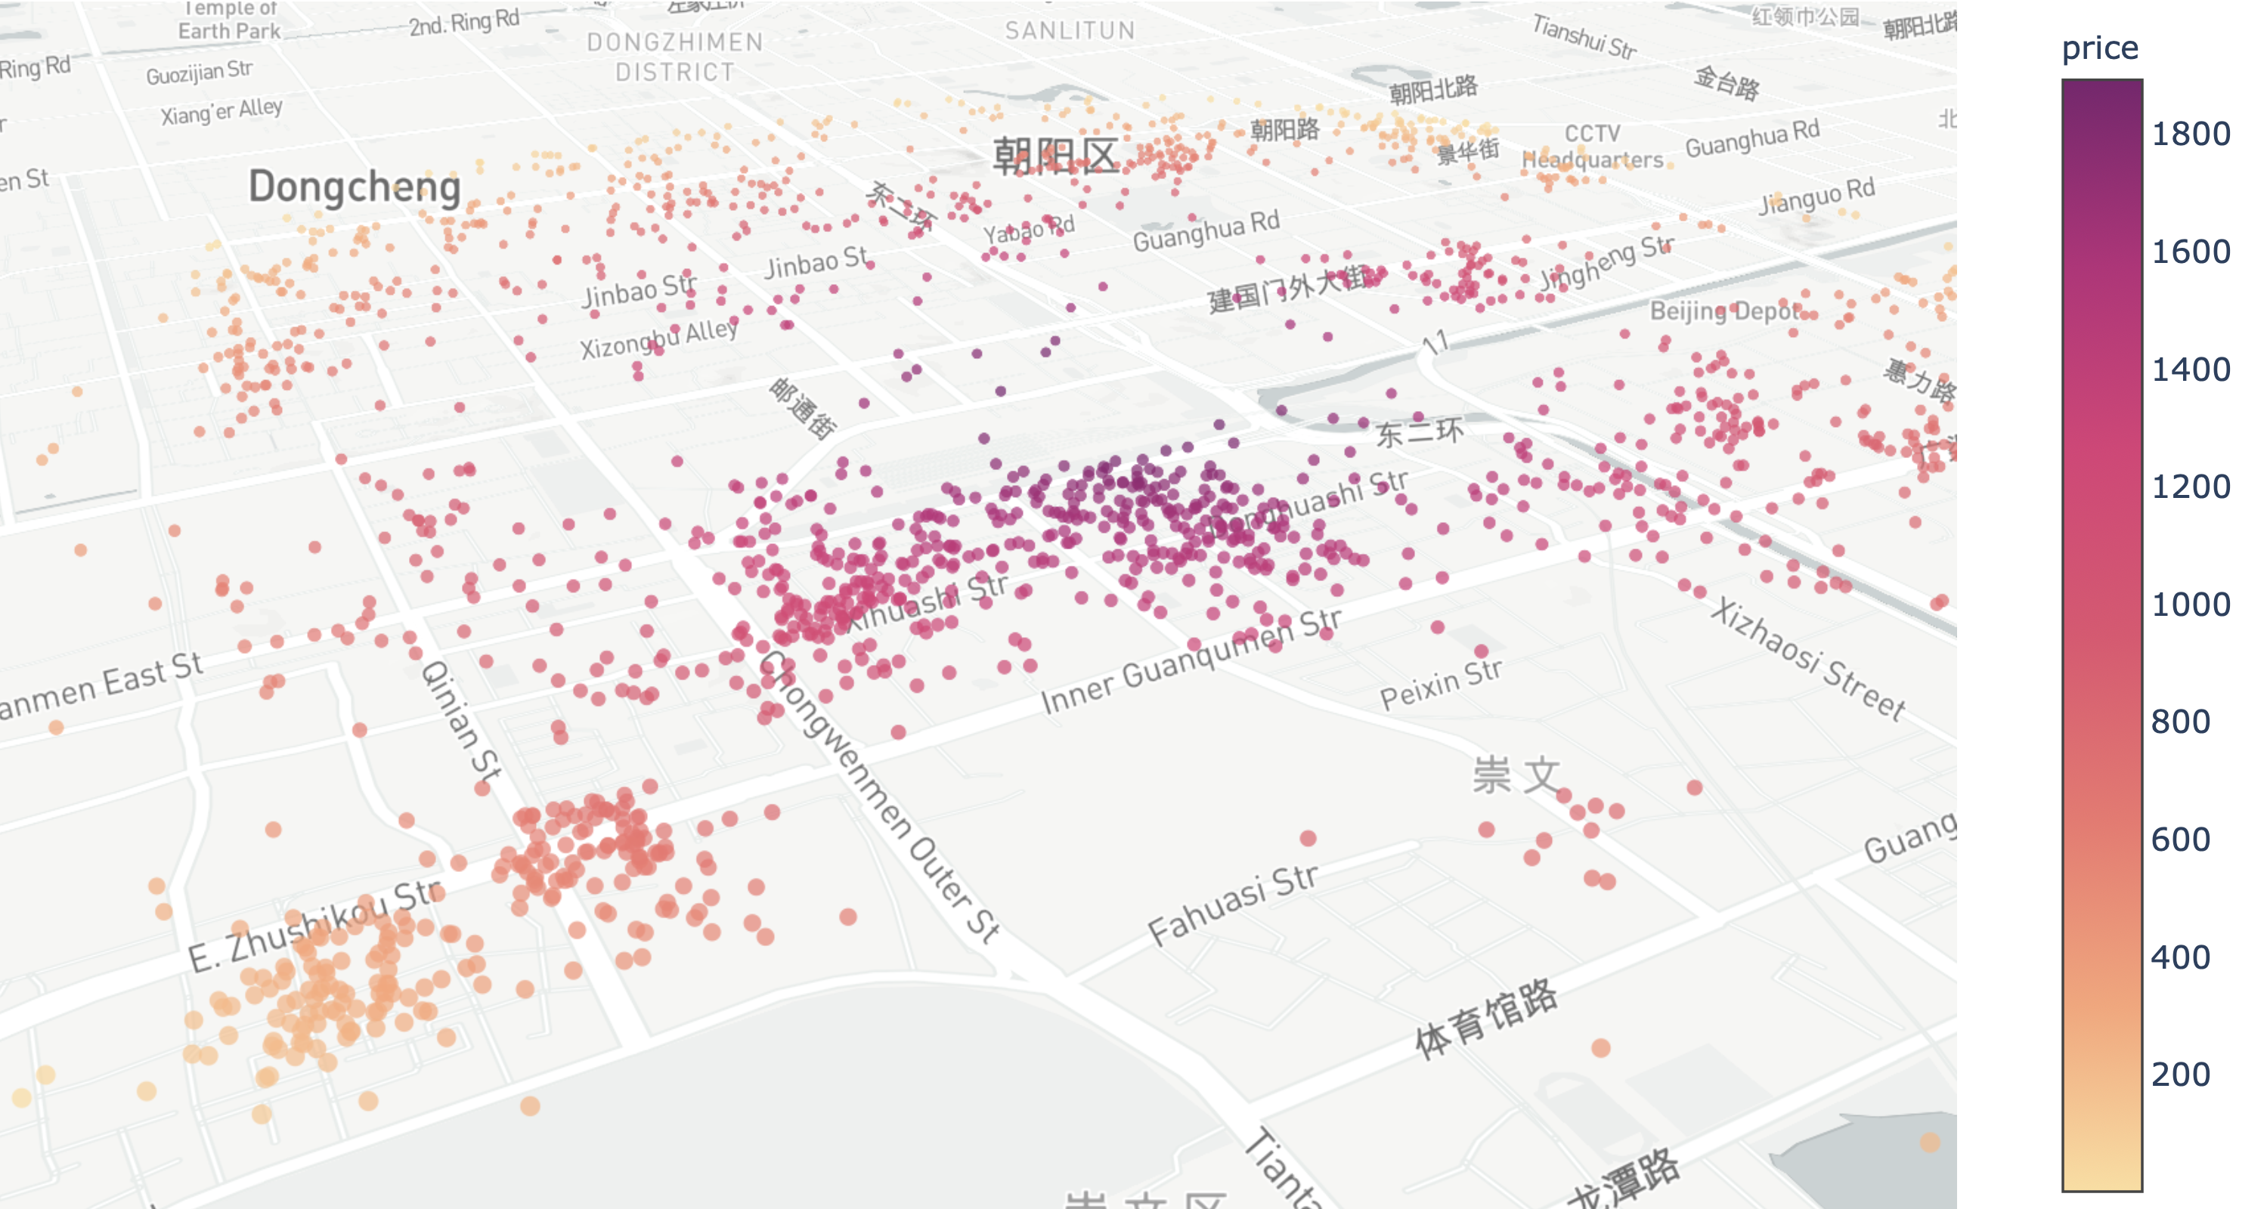

Motivation · Problem Definition · State-of-the-Art · Methodology · Evaluation
Feature Engineering
Railway Station

Slide 21
Motivation · Problem Definition · State-of-the-Art · Methodology · Evaluation
Feature Engineering
bathrooms
bedrooms
beds
bed type
……
availability
Extra people
Train Station
Airport
Wangjing SOHO
Yanqing IHE
……
Sanlitun
Subway
Feature
A / B / C
79
+
+
=
A | B | C
0 | 0 | 1
0 | 1 | 0
1 | 0 | 0
Features in total
Adding
Features
One-Hot Encoding

Slide 22
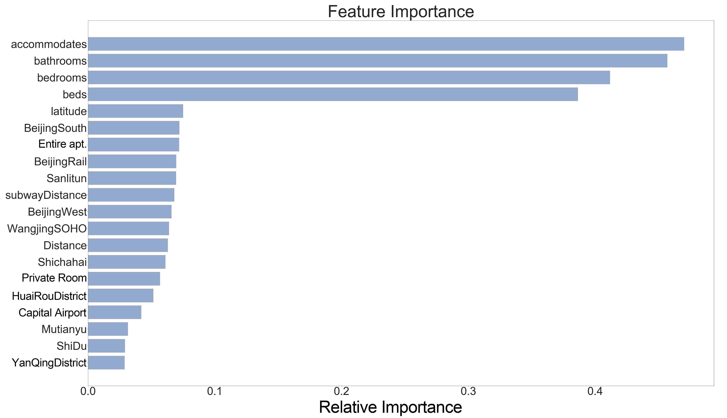
Motivation · Problem Definition · State-of-the-Art · Methodology · Evaluation

Slide 23
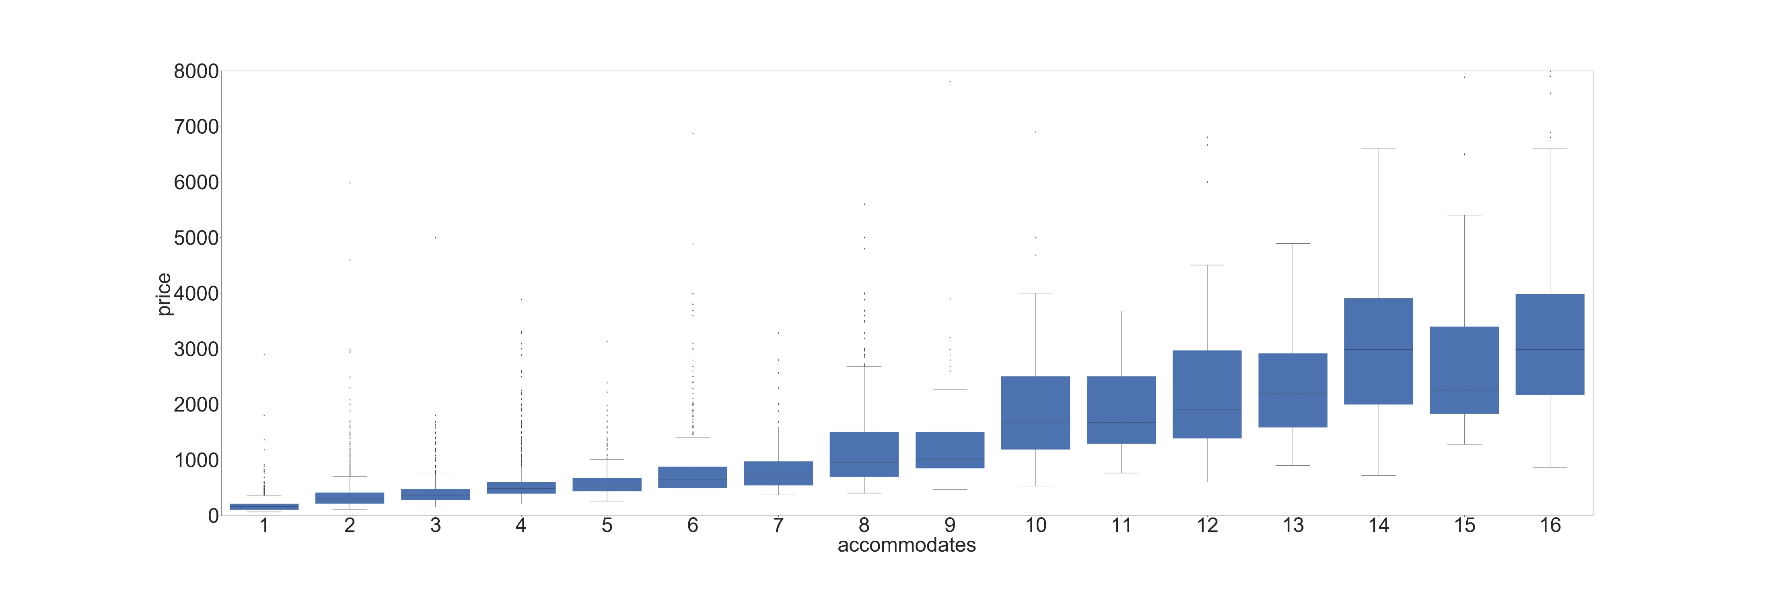
Motivation · Problem Definition · State-of-the-Art · Methodology · Evaluation
Accommodates-Price Box-plot

Slide 24
Motivation · Problem Definition · State-of-the-Art · Methodology · Evaluation

Slide 25

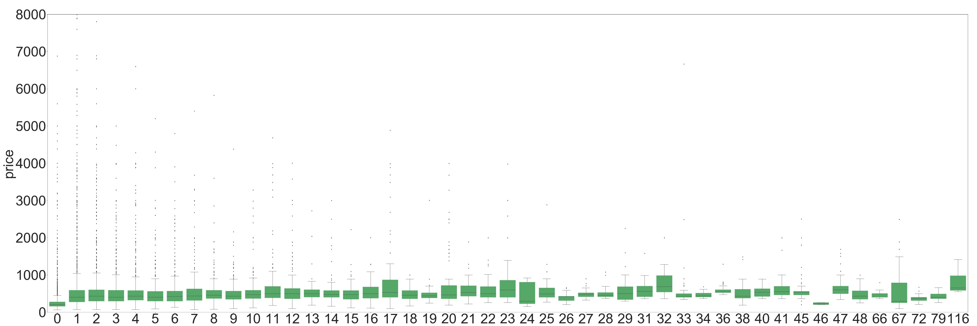
Motivation · Problem Definition · State-of-the-Art · Methodology · Evaluation
Figure X Feature Importance comparison
No. listings of host - Price

Slide 26
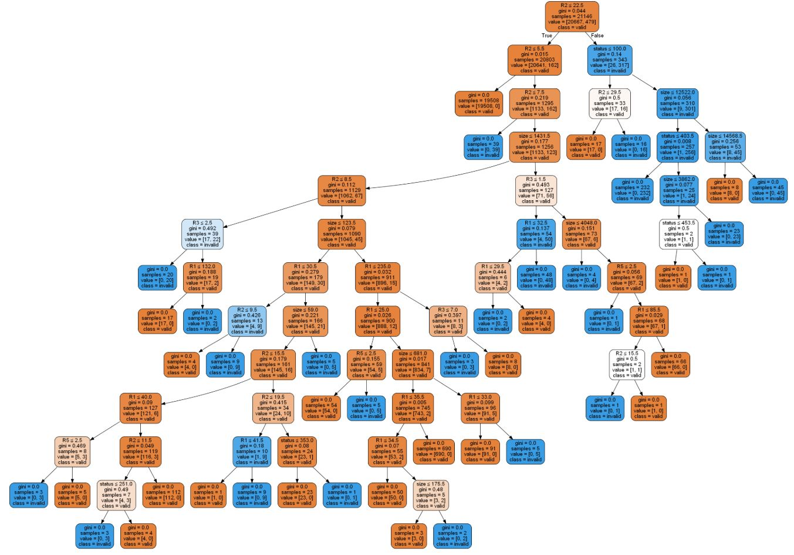






Motivation · Problem Definition · State-of-the-Art · Methodology · Evaluation
Model Building
Model
Scores
Grid Search
Cross Validation
PIPELINE
Splitted Data
Visuals
Train Dataset
80 %
Test
Dataset
20%

Slide 27
Evaluation

Slide 28
Motivation · Problem Definition · State-of-the-Art · Methodology · Evaluation
Model
Train Dataset
80 %
Test
Dataset
20%

Slide 29
Motivation · Problem Definition · State-of-the-Art · Methodology · Evaluation
Model Name | R² Score
Random Forest | 0.705
Artificial Neural Network | 0.712
Gradient Boosting | 0.745
eXtreme Gradient Boosting | 0.746

Slide 30
Motivation · Problem Definition · State-of-the-Art · Methodology · Evaluation
Model Name | R² Score
Random Forest | 0.705
Artificial Neural Network | 0.712
Gradient Boosting | 0.745
eXtreme Gradient Boosting | 0.746

Slide 31
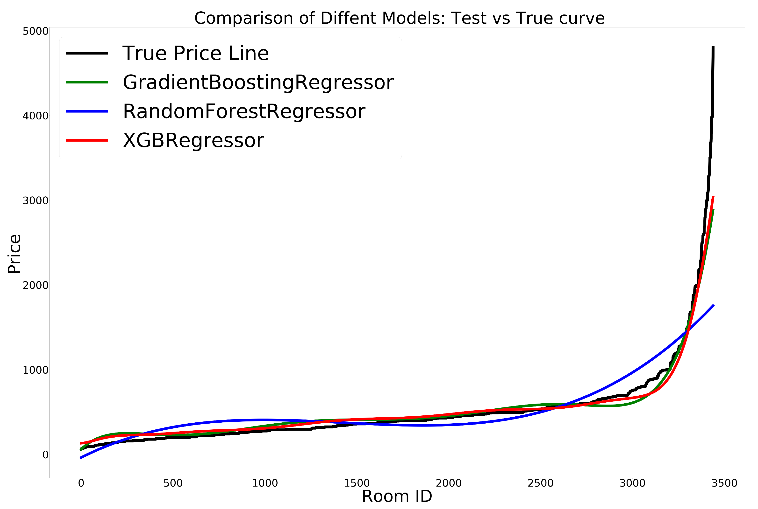
Motivation · Problem Definition · State-of-the-Art · Methodology · Evaluation

Slide 32

Motivation · Problem Definition · State-of-the-Art · Methodology · Evaluation

Slide 33

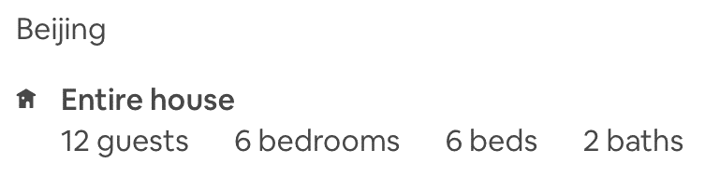
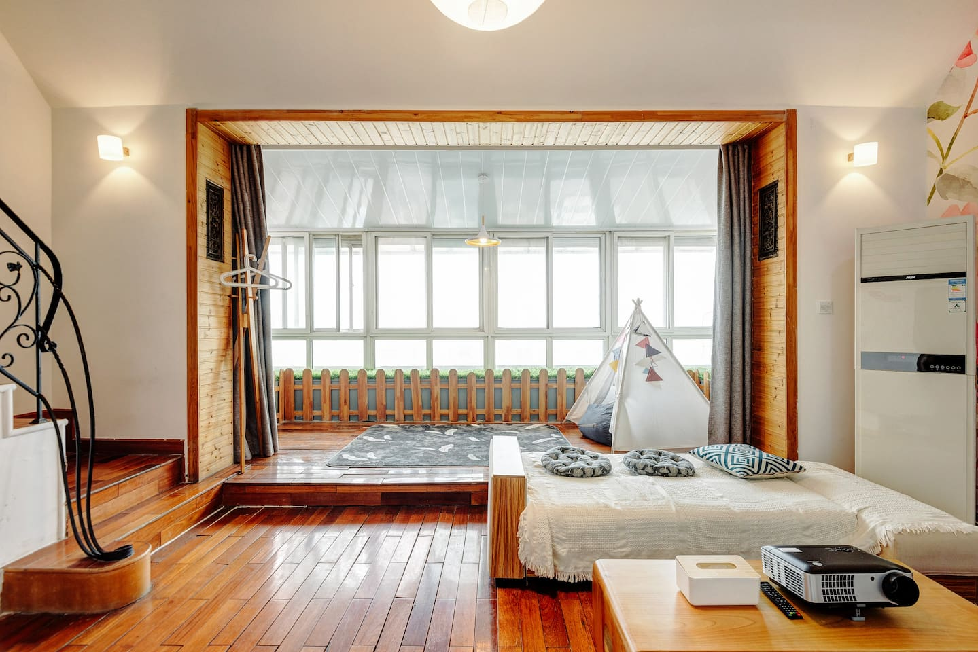
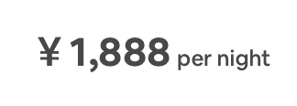
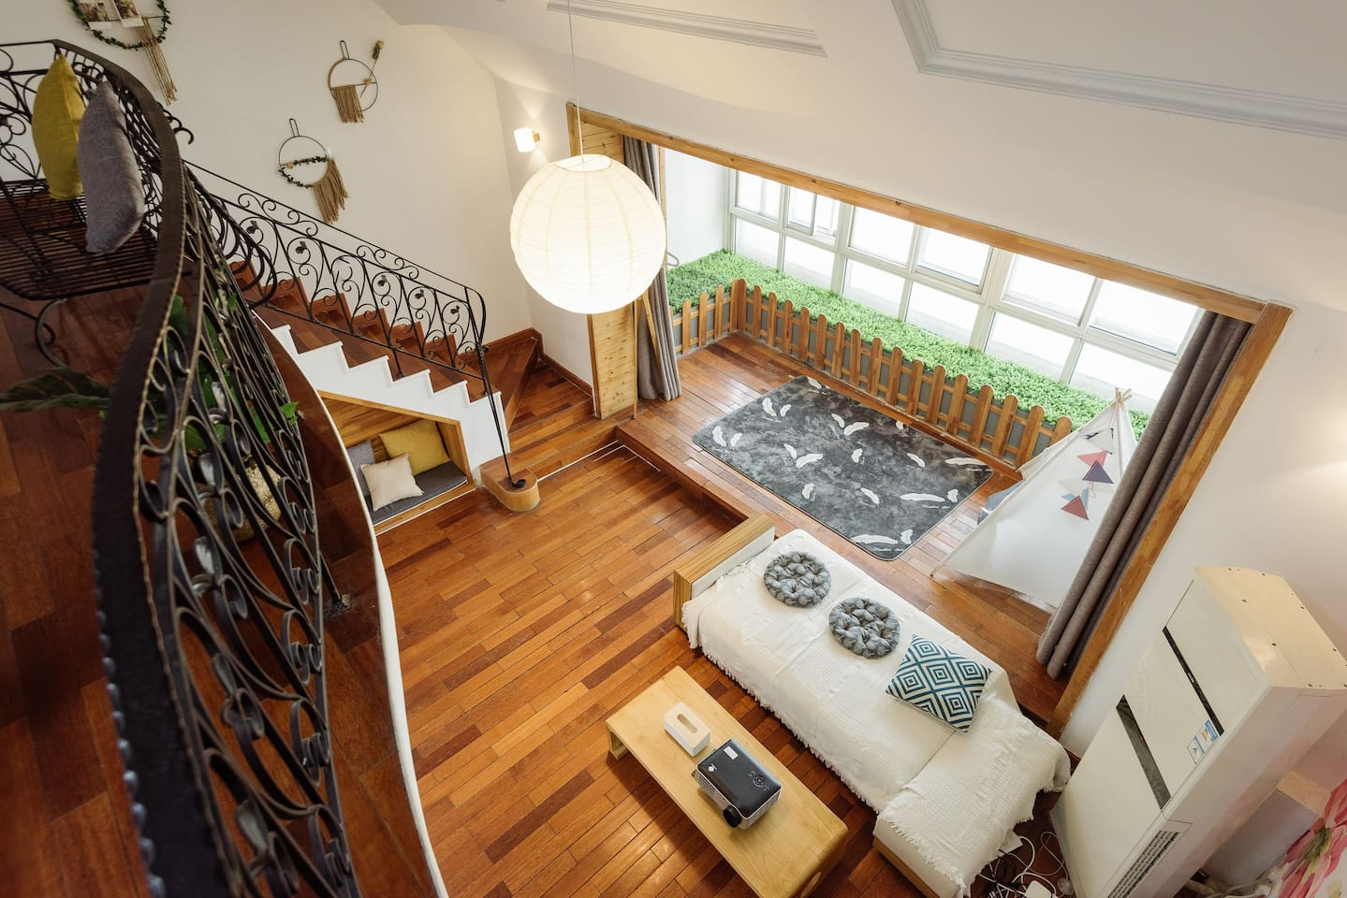
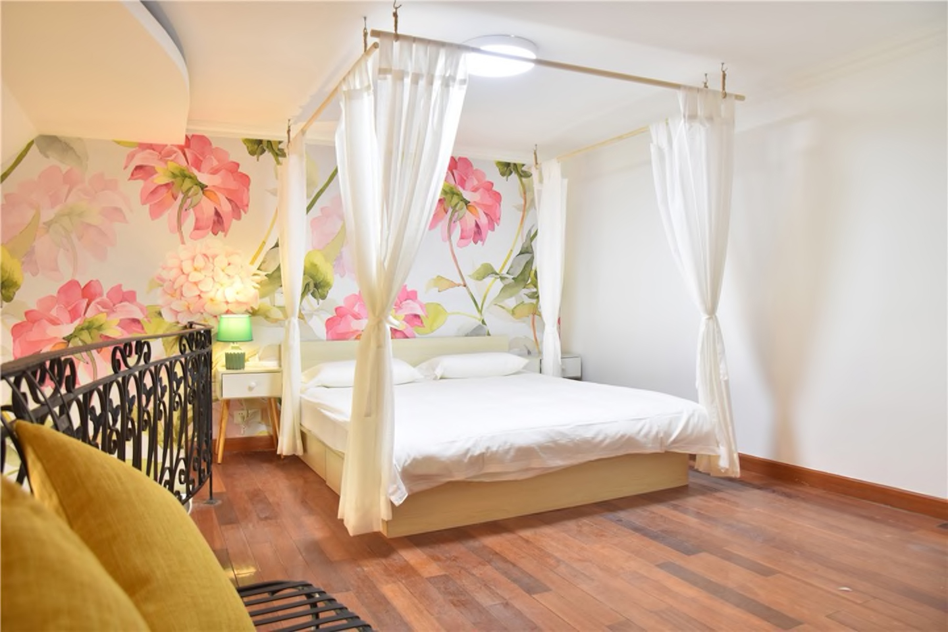
Motivation · Problem Definition · State-of-the-Art · Methodology · Evaluation
Model Name | R² Score | Prediction
Random Forest | 0.705 | ￥1798.06
Artificial Neural Network | 0.712 | ￥1820.95
Gradient Boosting | 0.745 | ￥1882.24
eXtreme Gradient Boosting | 0.746 | ￥1887.61

Slide 34
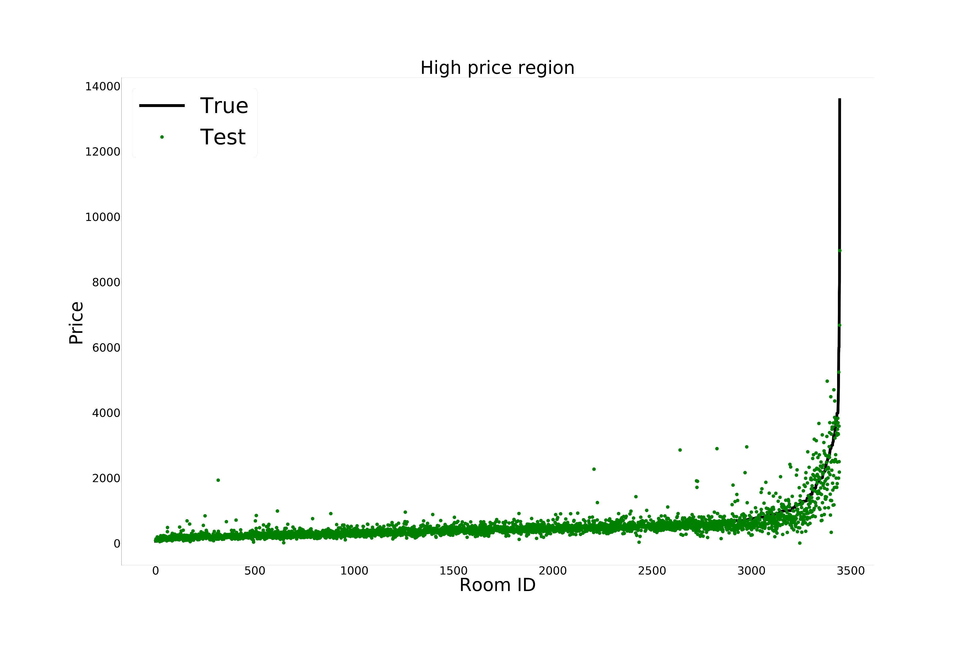
Motivation · Problem Definition · State-of-the-Art · Methodology · Evaluation
XGBoost

Slide 35
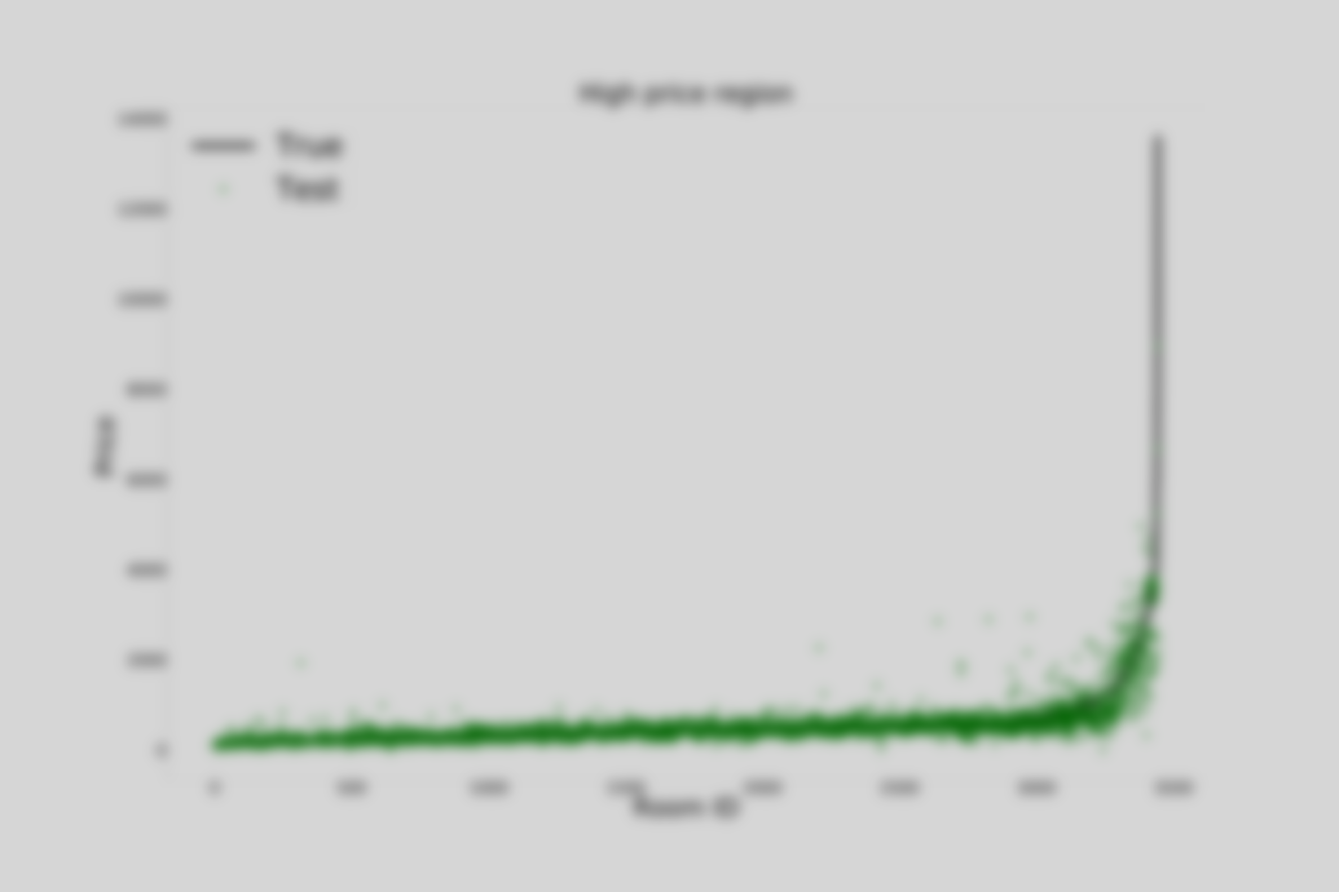
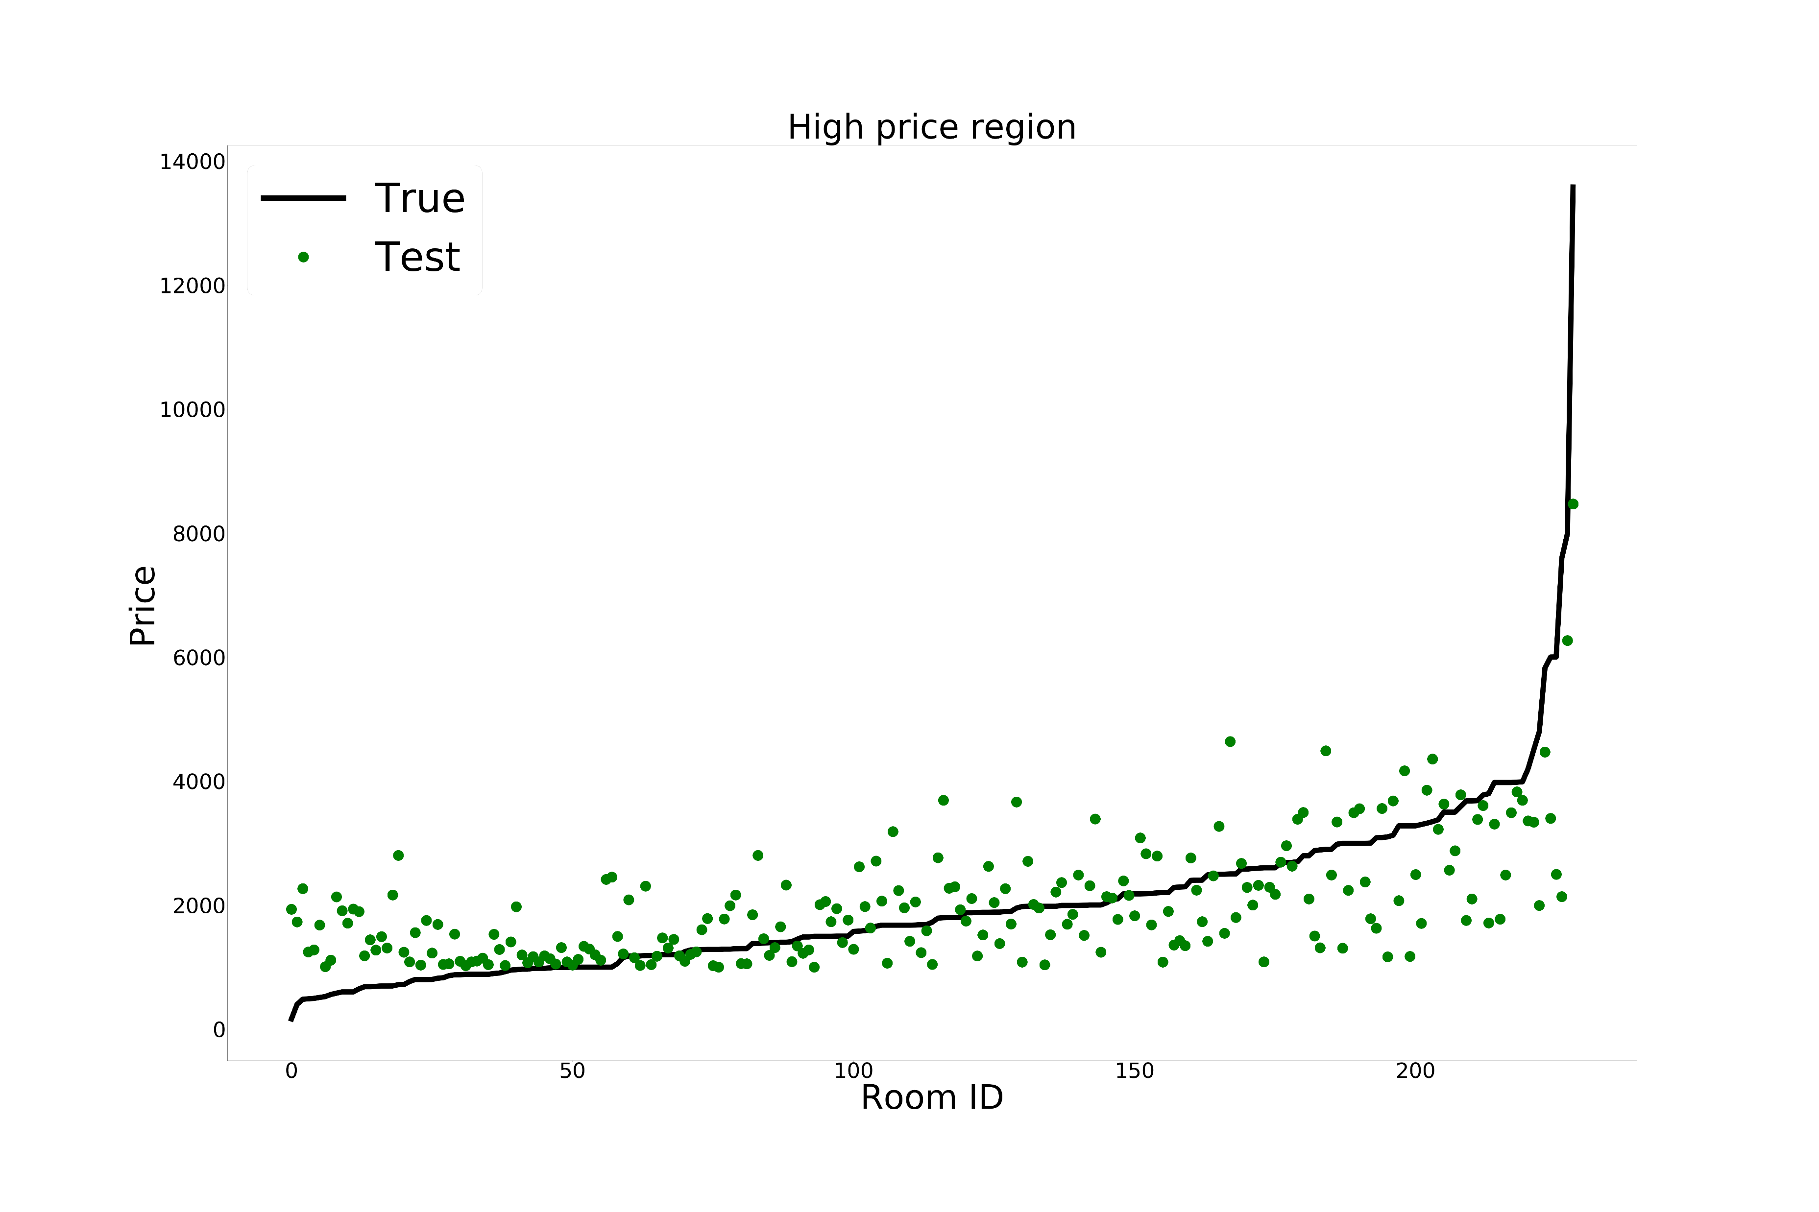
Motivation · Problem Definition · State-of-the-Art · Methodology · Evaluation

Slide 36
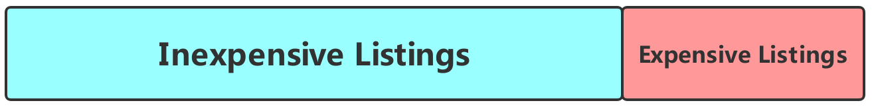
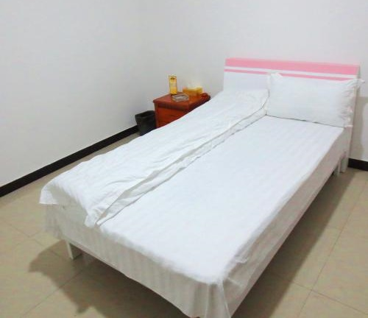

Error Analysis
Motivation · Problem Definition · State-of-the-Art · Methodology · Evaluation
Expensive listings have less data compared to inexpensive listings
Feature isn’t everything for price.
One Bed
One Bed
￥200
￥2348

Slide 37

Motivation · Problem Definition · State-of-the-Art · Methodology · Evaluation
To Wrap Up,
The Best Price is ￥800
3 Giant Rooms
豪宅
Swimming Pool
Big TVs
XGBoost | 0.746
Intelligent Machine
Landlord Mr. Lazy

Slide 38
Thank you!

Slide 39



Thank you! AI HUB

Slide 40

Q & A

